Slide 1
Beyond The Athlete, Leveraging Impact in the Sport Network
Patrick Smith, University of Nevada Reno
Emily Leeming, Ph.D., Armed Forces Services Corporation

Slide 2
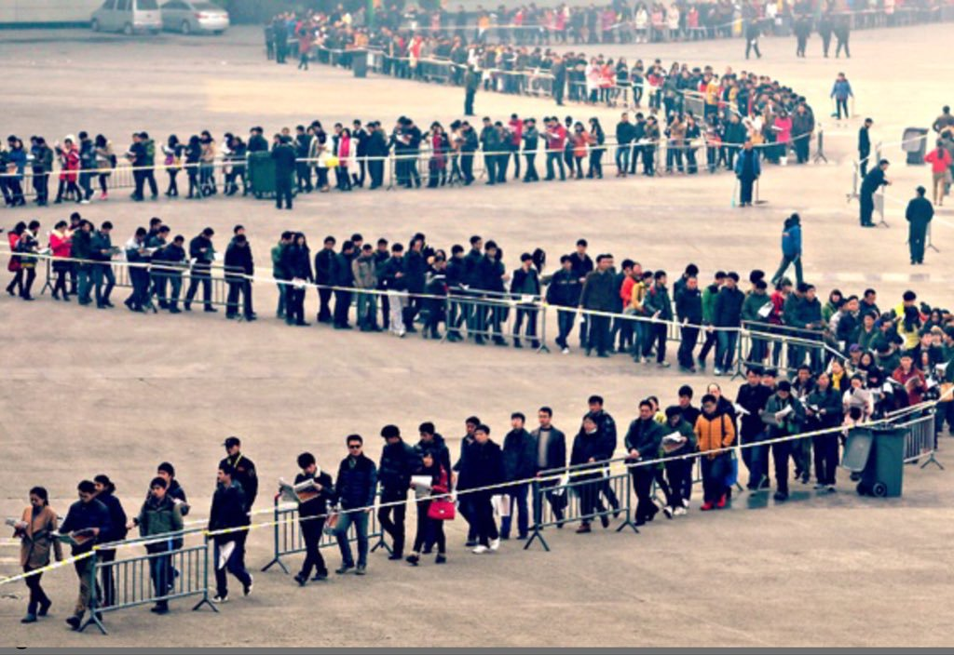
500 year Problem^{[1]}
* PatrickS@Nevada.unr.edu
Notes:
One athlete at a time isn’t going to cut it.

Slide 3
Empirical Opportunity
9 Behavioral or CBS Journals
JCBS, JABA, JEAB, JOBM, Beh Mod, JPBI, Psych Rec, BRaT, Mindfulness
4 Key Terms
Sport
Athlete
Coach
Trainer
86 Sport Related Results
Athlete Focused
84
Athlete Environment
2
* PatrickS@Nevada.unr.edu
Notes:
Your percentages and totals don’t add up to 100%. I’m assuming it’s because your going to make a direct point about it, but the miss aligned totals distract from the point when I just look at it. (removed the percentages and lowered the total to sport specific results)

Slide 4
Sport Network
International Association
Corporate Sponsors
National Governing Body
Team Organization
Coach Educator
Officials
Teammates
Coach
Athlete
Counselor
Family
Fans
* PatrickS@Nevada.unr.edu
Notes:
Might change “parents” to “family” as some athletes have significant others, married, have kids etc… (Good catch, thank you)

Slide 5
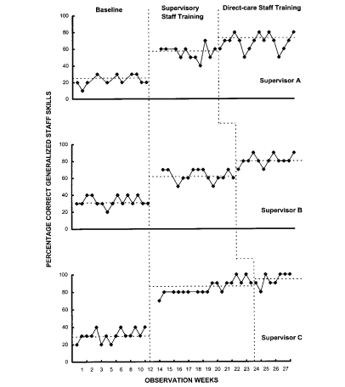
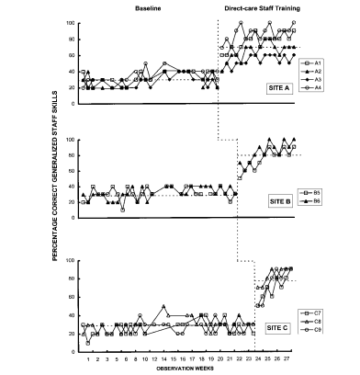
Pyramidal Training^{[2]}
Multiple Baseline Intervention
Measuring Behavior At:
Direct Trainee [Tier 1]
Indirect Trainee [Tier 2]
.
.
Service Consumer [Tier N]
Tier 1
Supervisor Training
Tier 2 & 3
Staff & Client Behavior
* PatrickS@Nevada.unr.edu
Notes:
Tony Biglan – Nurses partnering with at risk mothers during pregnancy
ProSocial

Slide 6
Implications
International Association
Corporate Sponsors
National Governing Body
Team Organization
Coach Educator
Officials
Teammates
Coach
Athlete
Counselor
Family
Fans
* PatrickS@Nevada.unr.edu
Notes:
Luxurious Navel Gazing
Green => Address performance benefits
Blue => Address burnout benefits (or adversity tolerance benefits) ← but always? Sometimes they make calls on your side. Are they the only ones, i.e., fans, and specific kinds of coaching styles can also blur these lines? (Please clarify. Not sure what you are highlighting here.) What about the ones that are still brown? (I’m not sure how to approach them just yet. Maybe workplace benefits or prosocial targets)
Orange => Doing good

Slide 7
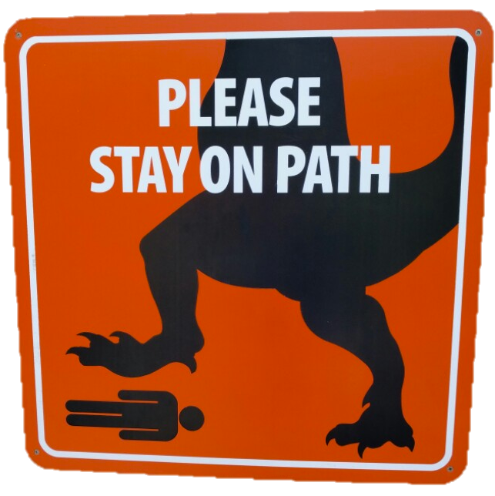
Pragmatic Considerations^{[3]}
Speak To Their Values
Leverage Current Behavioral Measures
Expect Small but Widespread Effects
* PatrickS@Nevada.unr.edu

Slide 8
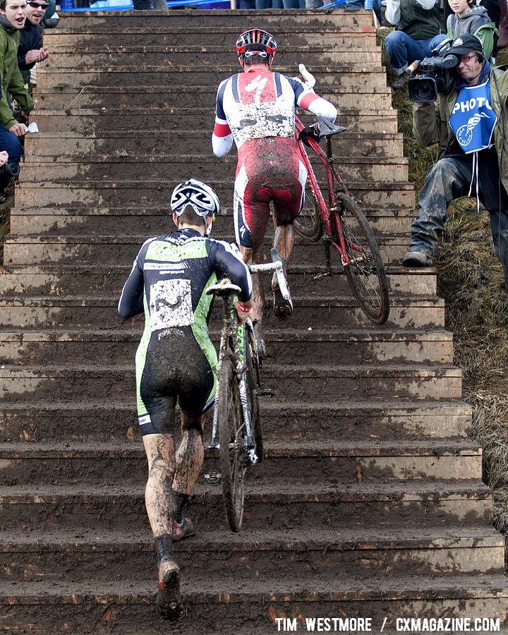
Next Steps
Steal This Idea
* PatrickS@Nevada.unr.edu
Notes:
Continuing the literature review and widening the scope.
Connect
Within
Beyond
Collaborate
Stand on Our Shoulders
Disseminate

Slide 9
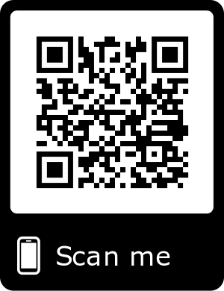
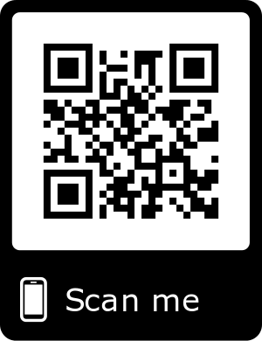
Thank You
Patrick Smith, University of Nevada Reno
* PatrickS@Nevada.unr.edu
Emily Leeming, Ph.D., Armed Forces Services Corporation
* Emily.Leeming16@gmail.com
Literature Search Terms & Data
This Slide Deck

Slide 10
References
[1] Hayes, S. C., Barlow, D. H., & Nelson-Gray, R. O. (1999). The scientist practitioner: Research and accountability in the age of managed care. Allyn & Bacon.
[2] Ducharme, J. M., Williams, L., Cummings, A., Murray, P., & Spencer, T. (2001). General case quasi-pyramidal staff training to promote generalization of teaching skills in supervisory and direct-care staff. Behavior Modification, 25(2), 233-254.
[3] Biglan, A., & Barnes-Holmes, Y. (2015). Acting in light of the future: How do future-oriented cultural practices evolve and how can we accelerate their evolution?. Journal of contextual behavioral science, 4(3), 184-195.

Slide 12
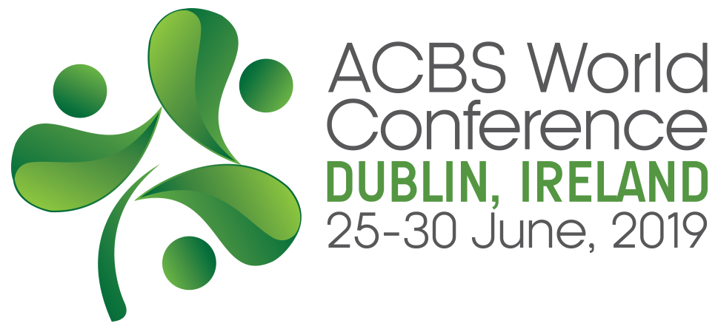

Slide 13
Disclosures (no support):
Patrick Smith, Emily Leeming
We have not received and will not receive any commercial support related to this presentation or the work presented in this presentation.

